Slide 1
Analyzing U.S. Accident Patterns Through Advanced Visual Analytics
PRESENTED BY:
TEAM INSIGHT FOUNDRY
Prabhitha Veeramachaneni
Pranay Reddy Gundala
Jaswanth Kranthi Boppana

Slide 2
INTRODUCTION
Road safety is a critical concern in the U.S., where accidents occur frequently, impacting countless lives and straining resources. This project leverages the extensive “U.S. Accidents” dataset, which spans years and geographies, capturing over 7.7 million incidents through 46 detailed attributes. These include accident severity, environmental conditions, and location-specific factors, offering a unique opportunity to uncover meaningful patterns and trends. By analyzing this data, we aim to gain insights into the underlying causes of accidents and identify actionable strategies for prevention.
Through visualizations and in-depth analysis, this project explores how factors such as weather, infrastructure, and geography influence accident risks. By highlighting regional hotspots and uncovering environmental triggers, our work provides valuable insights for urban planners, policymakers, and everyday drivers. This data-driven approach not only deepens our understanding of accident dynamics but also offers practical solutions to create safer roadways, paving the way for a future where data saves lives.

Slide 3
MOTIVATION
Despite advancements in technology and road safety measures, traffic accidents in the U.S. continue to pose a serious public health and economic challenge. Each incident reflects a preventable loss or disruption, often rooted in patterns hidden within complex data. Factors like environmental conditions, time, and geography interact in ways that traditional analyses often overlook, hindering proactive solutions and effective safety interventions.
By leveraging the extensive "U.S. Accidents" dataset and employing advanced visualization techniques, we aim to uncover actionable insights that are both accessible and impactful. This project seeks to guide urban planners, policymakers, and communities toward data-driven decisions, ultimately contributing to meaningful improvements in road safety. The potential to transform this data into tangible safety outcomes is the driving force behind this initiative.

Slide 4
DATA
The U.S. Accidents dataset is a comprehensive resource for analyzing road accidents across the United States, containing over 7.7 million records spanning multiple years. It is organized into 46 columns encompassing numeric, categorical, and textual attributes that provide a detailed view of accident conditions. These attributes include accident-specific details like severity, timestamps, distance, and descriptions; location-based data such as latitude, longitude, city, and state for spatial analysis; and environmental factors like weather conditions, temperature, visibility, and precipitation for understanding external influences.
The dataset also includes Points of Interest indicators, such as nearby traffic signals or junctions, offering insights into the role of road infrastructure in accidents. Additionally, geospatial and temporal information supports mapping and trend analysis over various time frames. While some columns contain missing values, particularly in environmental variables, the dataset remains a robust tool for visualizing accident patterns and deriving actionable insights to improve road safety.

Slide 5
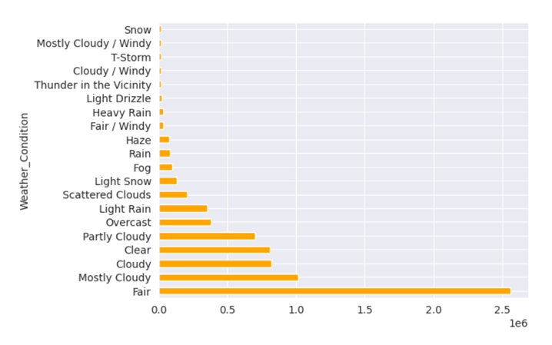
EXISTING VISUALIZATION
Weather Conditions and Accident Frequencies
This bar chart provides a ranking of weather conditions based on accident frequency, highlighting that "Fair" and "Mostly Cloudy" conditions are the most prevalent during accidents. While the chart is simple and easy to understand, the high frequency of these conditions is likely due to their overall occurrence rather than an increased accident risk.
However, the visualization does not account for accident severity, limiting its usefulness in identifying hazardous weather conditions. Incorporating elements such as severity levels through color-coding or a stacked bar format could enhance the chart by offering more actionable insights into the risks associated with different weather conditions.

Slide 6
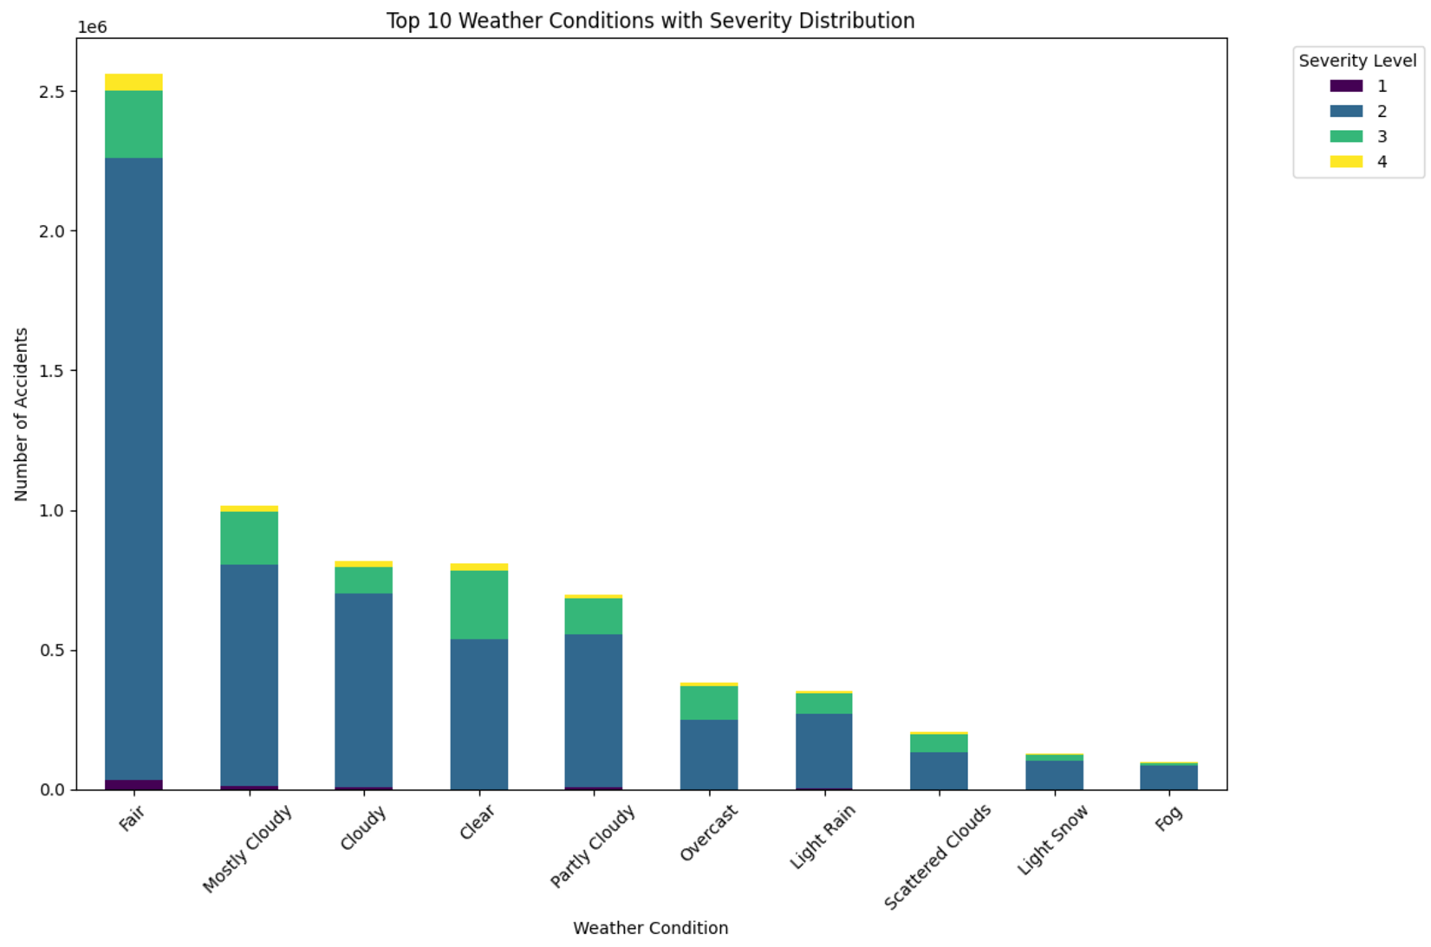
IMPROVISATION
Weather Conditions and Accident Frequencies
This improved visualization addresses the shortcomings of the original by incorporating accident severity through a stacked bar chart. It focuses on the top 10 weather conditions, offering a more concise and relevant analysis while avoiding less impactful data.
By visualizing severity levels within each weather condition, this chart goes beyond just accident frequency to reveal the relative risks associated with different conditions. This enhancement provides a more nuanced perspective, enabling a better understanding and mitigate the impact of weather on road safety.

Slide 7
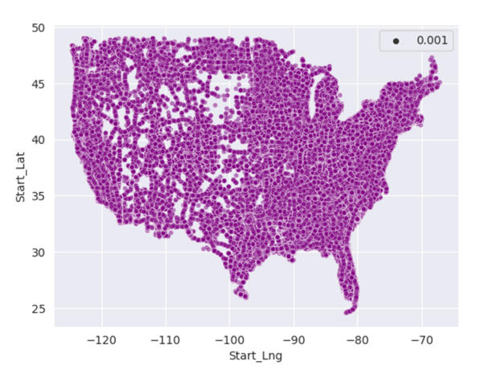
EXISTING VISUALIZATION
Accident locations
The current scatter plot provides a clear overview of accident locations across the U.S., effectively illustrating how incidents are distributed geographically. By mapping each accident as a point, the visualization highlights areas of higher density, such as urban centers and major highways.
However, the uniform representation of all accidents limits the ability to distinguish variations in frequency and severity. In regions with high accident density, significant overlaps make it challenging to uncover patterns or focus on critical zones requiring intervention.

Slide 8
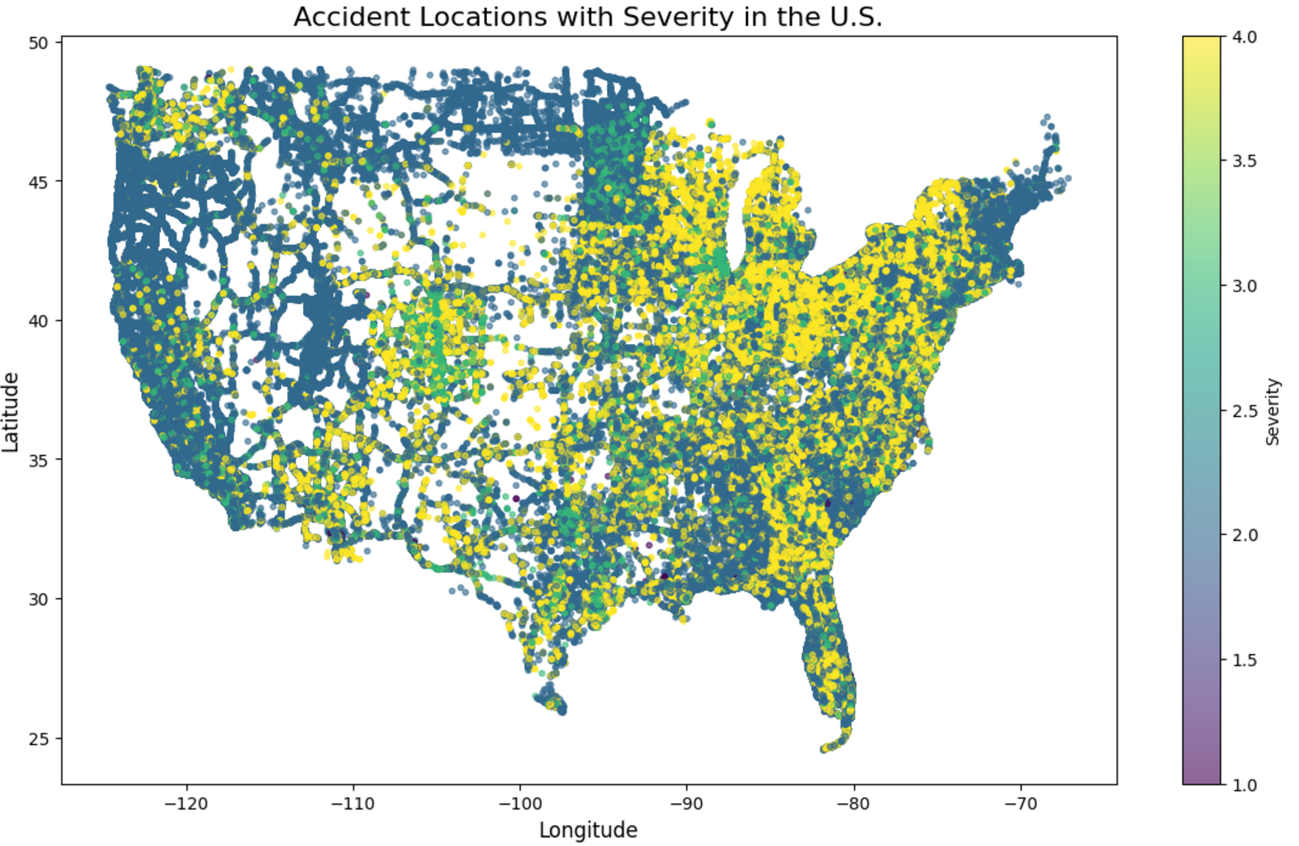
IMPROVISATION
Accident Locations
This improved scatter plot addresses the clutter in the original visualization by incorporating transparency, making it easier to identify patterns in densely populated accident areas. A color gradient is added to represent accident severity, differentiating severity levels with a spectrum of colors.
This enhancement provides dual insights into accident density and criticality, helping prioritize high-severity zones for targeted safety measures. By transforming raw geographic data into actionable insights, this visualization supports informed decisions for improving road safety.

Slide 9
DATA VISUALIZATIONS
AND
INSIGHTS

Slide 10
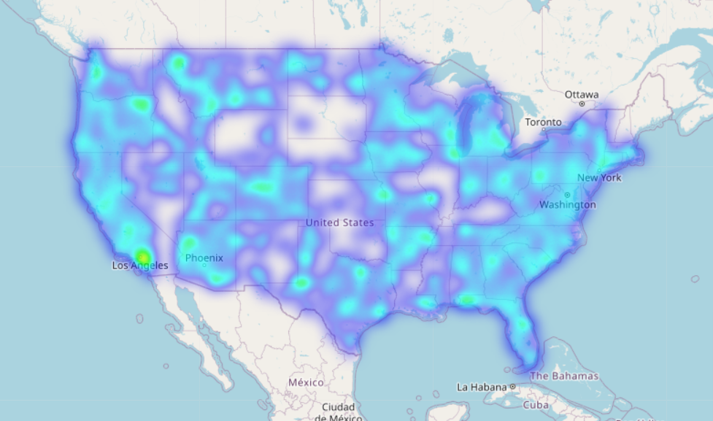
Geospatial Heatmap of Accident Density for the last 4 months
This heatmap visualizes accident density across the United States, with brighter regions indicating higher concentrations of incidents. Major metropolitan areas like Los Angeles, New York, and Phoenix stand out as accident hotspots, likely due to heavy traffic and urban congestion. The widespread distribution of accidents highlights the need for localized safety measures in high-density regions to address specific traffic challenges.

Slide 11
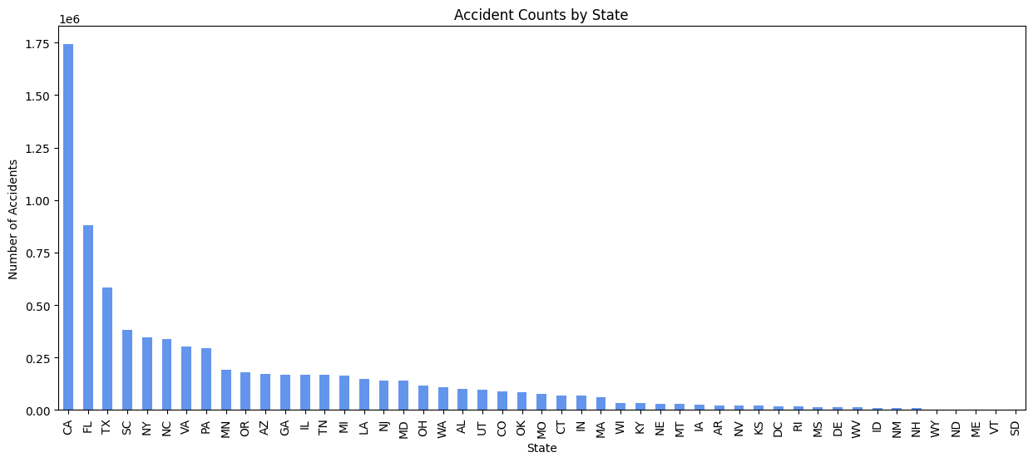
Accidents Count by state
This bar chart shows the distribution of accident counts by state, highlighting the states with the highest number of reported incidents. California, Florida, and Texas lead with the highest accident frequencies, likely due to their large populations, extensive road networks, and heavy traffic. The steep drop-off in counts for other states emphasizes a significant disparity in accident occurrences. These trends suggest that high-traffic states may require more targeted safety measures to address their elevated accident rates.

Slide 12
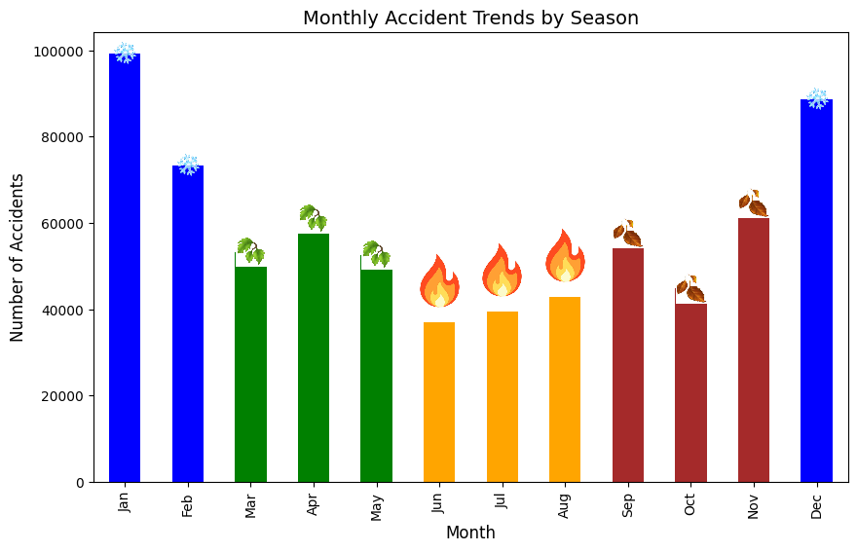
MONTHLY ACCIDENT TRENDS BY SEASON
This bar chart illustrates monthly accident trends categorized by season, showing peaks in January, February, and December during winter months. The higher accident counts in winter may be attributed to hazardous conditions like snow and ice.
Summer months show relatively lower accident rates, likely due to favorable weather and improved road conditions. These insights emphasize the importance of seasonal-specific safety measures, particularly in winter.

Slide 13
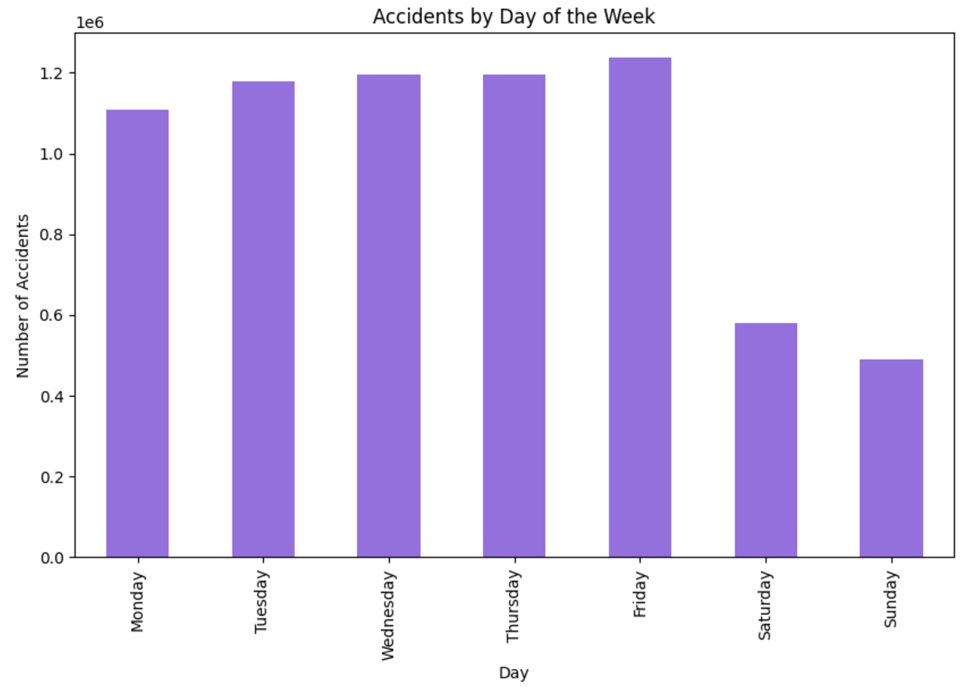
ACCIDENTS BY DAY OF THE WEEK
This bar chart shows the distribution of accidents by day of the week, with weekdays experiencing significantly higher accident counts compared to weekends. Friday records the highest number of incidents, likely due to increased traffic as people commute and prepare for the weekend.
In contrast, Saturday and Sunday see fewer accidents, reflecting reduced commuter traffic. These patterns suggest a focus on weekday traffic management could effectively reduce accidents.

Slide 14
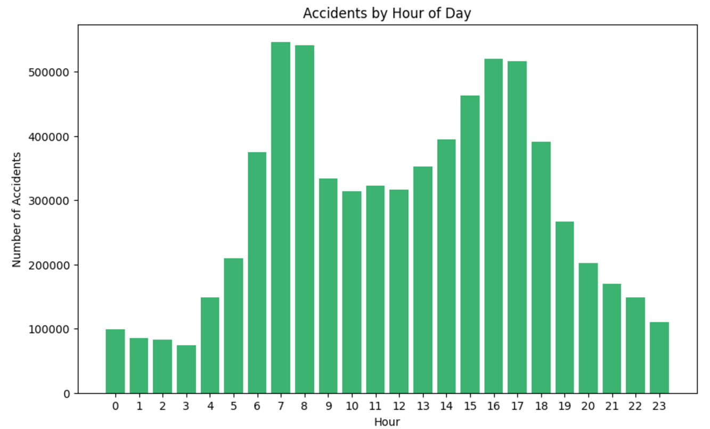
ACCIDENTS BY HOUR OF THE DAY
This bar chart shows the distribution of accidents by hour of the day, with peaks during morning rush hours (7–9 AM) and evening rush hours (4–6 PM). These spikes correspond to high traffic volumes during commuting periods, potentially influenced by driver fatigue or distractions.
In contrast, accidents are significantly lower during late-night and early-morning hours (11 PM–4 AM) due to reduced road usage. These patterns suggest prioritizing safety measures during peak traffic hours.

Slide 15
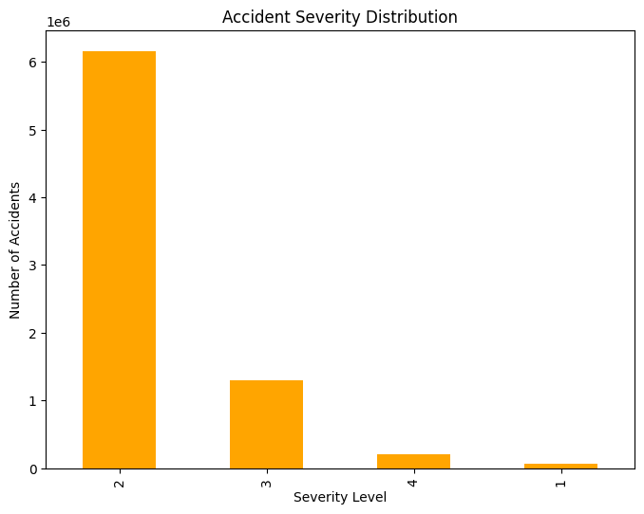
ACCIDENT SEVERITY DISTRIBUTION
This bar chart depicts the distribution of accidents by severity level, showing that the majority of accidents are classified as severity level 2, followed by level 3. Levels 1 and 4 account for a much smaller proportion of accidents.
This suggests that while most accidents are moderate in impact, severe accidents (level 4) are relatively rare. These insights emphasize the importance of targeting moderate-severity accidents to improve overall road safety.

Slide 16
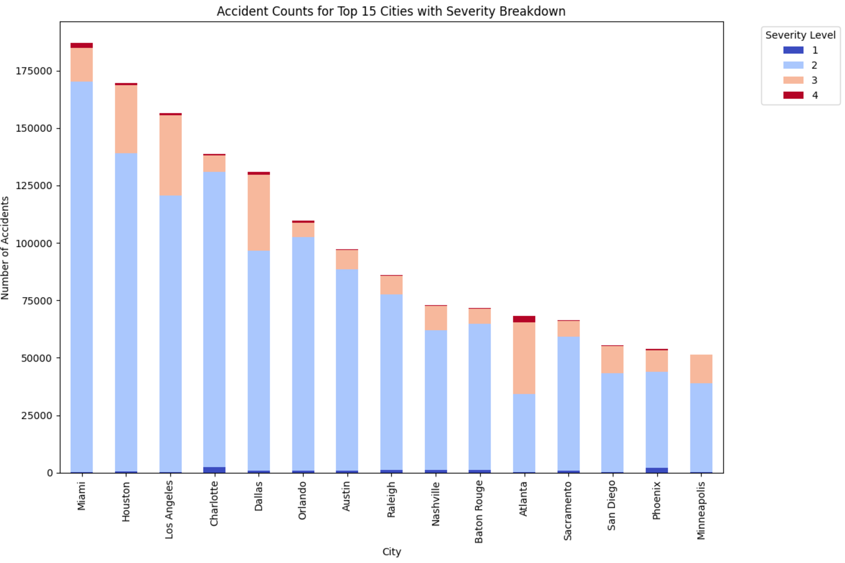
Top 15 cities with accident counts & severity breakdown
This bar chart displays accident counts for the top 15 cities, categorized by severity levels. Miami, Houston, and Los Angeles lead in total accident counts, with most incidents falling under moderate severity (level 2). The inclusion of severity breakdown highlights the variation in risk levels across cities. This detailed view enables better-targeted safety measures in high-risk urban areas.

Slide 17
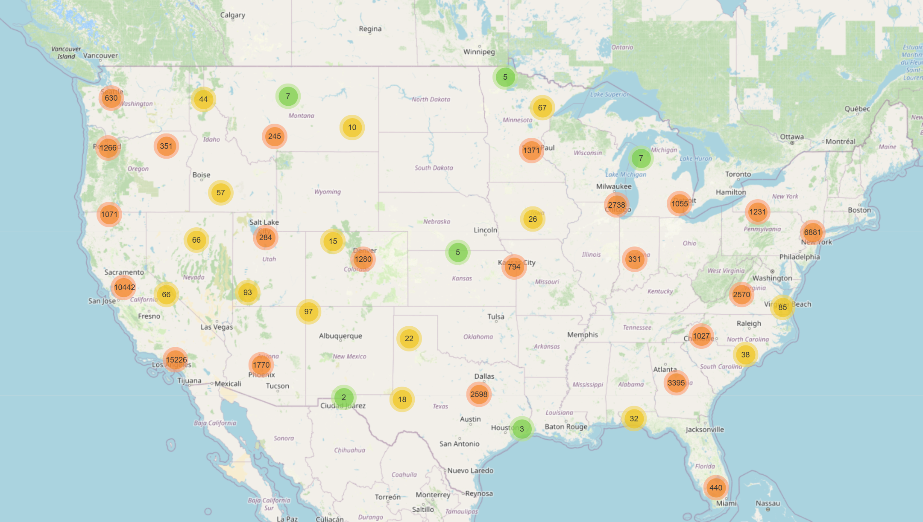
Accident Clusters by Severity (Last 2 Months)
This interactive map visualizes the distribution of accidents and severity across major U.S. cities using clustered markers, with color intensity reflecting accident frequency. High accident concentrations are observed in densely populated areas like Los Angeles, New York City, and Chicago, emphasizing the role of urban density in accidents. Conversely, regions with lower population densities, such as Montana and Kansas, exhibit significantly fewer accidents. This insight highlights the potential for targeted urban planning and resource allocation to mitigate risks in high-density zones.

Slide 18
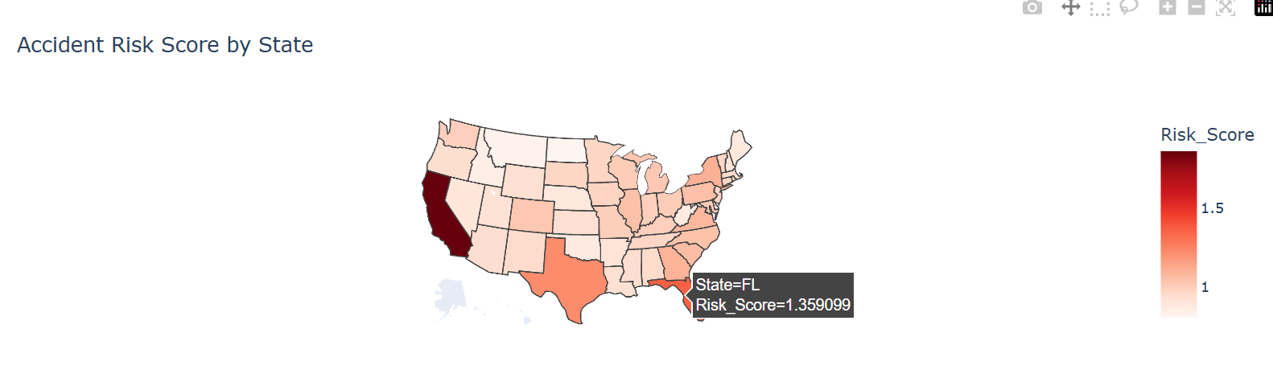
ACCident risk score by state
This choropleth map visualizes accident risk scores by state, calculated by normalizing the average accident severity and total accident counts. States like California and Florida show the highest risk scores, highlighting areas with both frequent and severe accidents. The darker shades on the map pinpoint regions requiring immediate attention for road safety improvements. This method provides a comprehensive view of risk by combining accident frequency and impact, offering actionable insights for targeted interventions.

Slide 19
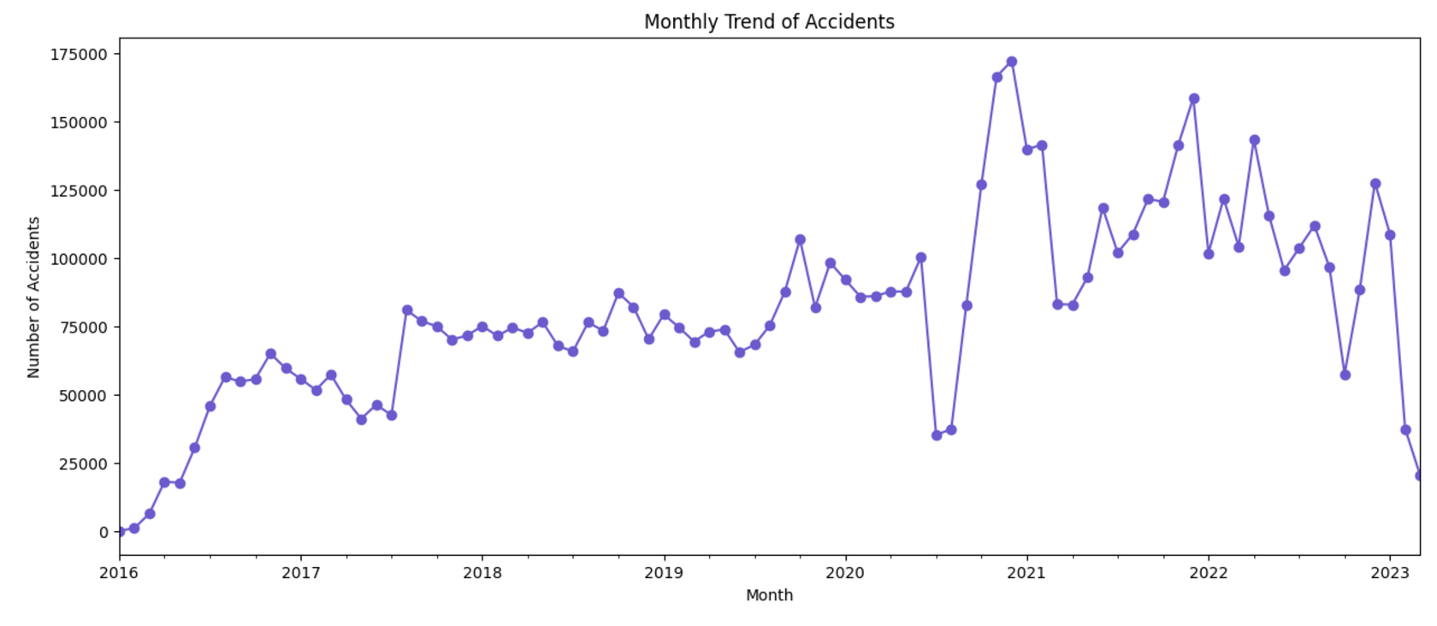
Monthly trend of accidents
This line chart displays the monthly trend of accidents from 2016 to 2023, highlighting fluctuations over time. A significant increase is observed around 2020, followed by a sharp drop, possibly linked to changes in travel patterns during the COVID-19 pandemic. The general upward trend in earlier years reflects increasing road activity. These insights emphasize the influence of external factors on accident rates over time.

Slide 20
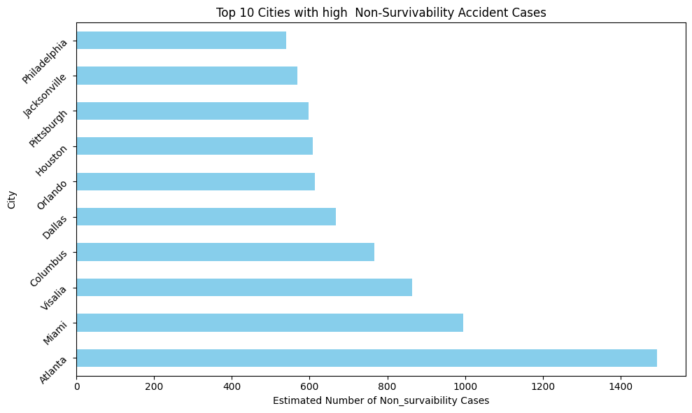
TOP 10 cities with high non surivivability accident cases
This bar chart highlights the top 10 cities with high non-survivable accident cases, calculated based on accidents lasting over an hour, with severity levels above 3, and without nearby amenities. Atlanta and Miami lead the list, indicating areas with significant challenges in accident survivability.
The lack of amenities and extended accident durations likely contribute to lower survival rates in these cities. These insights underline the importance of improving emergency response infrastructure and amenities to enhance survivability in high-risk locations.

Slide 21
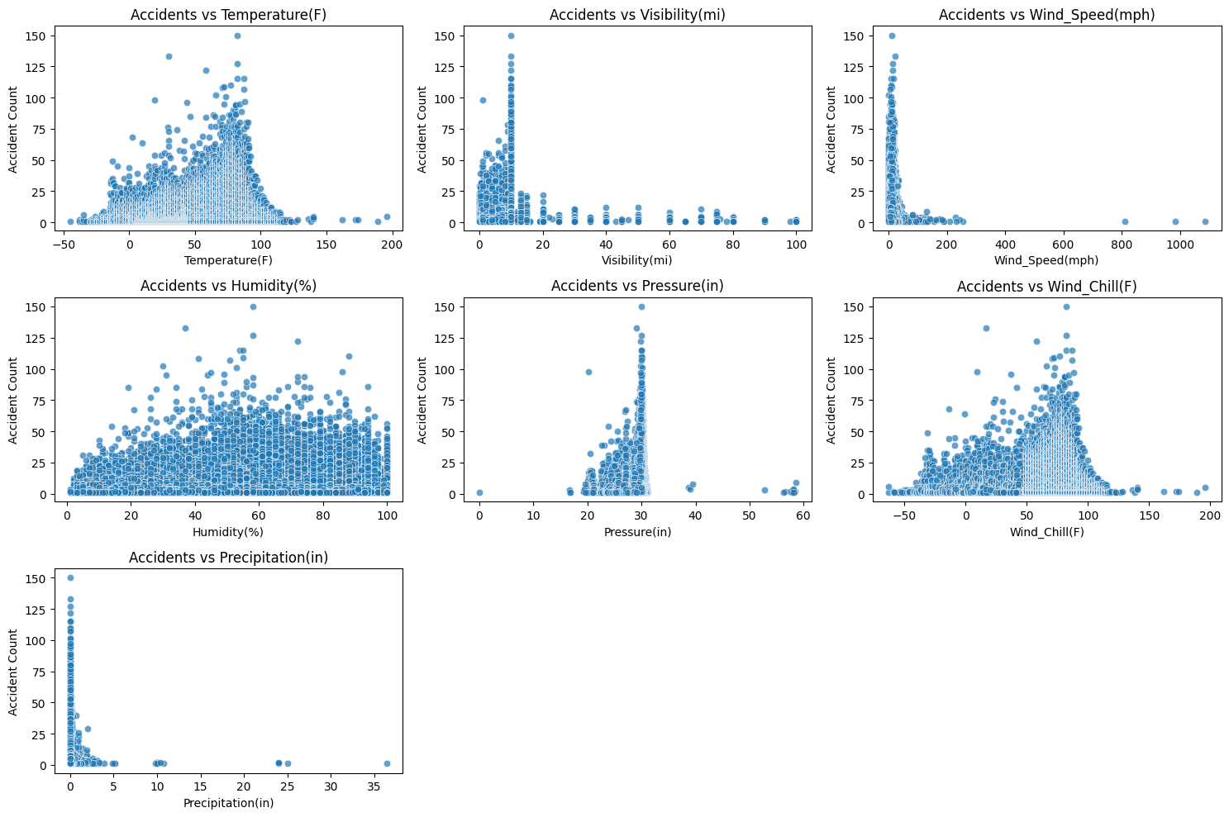
Accident count vs weather conditions
These scatter plots explore the relationship between accidents and various environmental factors, such as temperature, visibility, wind speed, humidity, pressure, wind chill, and precipitation. Accidents tend to occur more frequently at moderate temperatures and wind chill values, while low visibility and high precipitation are associated with higher accident counts.
Factors like wind speed and pressure show weaker correlations, indicating their limited impact on accident frequency. These visualizations highlight the significance of specific environmental conditions in contributing to road accidents.

Slide 22
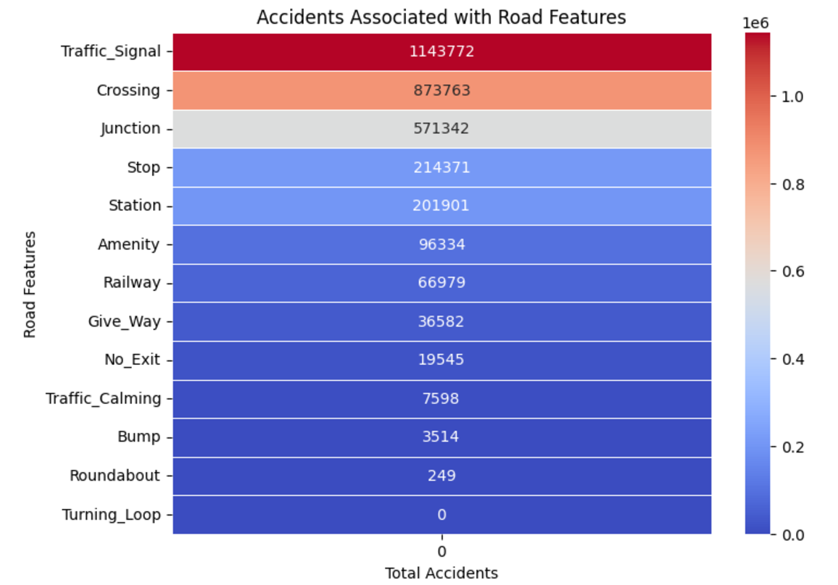
ACCIDENTS ASSOCIated with road features
This heat map illustrates the total number of accidents associated with different road features. Traffic signals, crossings, and junctions are linked to the highest accident counts, indicating their role as high-risk areas due to increased traffic flow and pedestrian activity.
Features like roundabouts and turning loops show minimal accident associations, suggesting safer traffic patterns. These insights highlight the importance of targeted interventions at high-risk features to improve road safety.

Slide 23
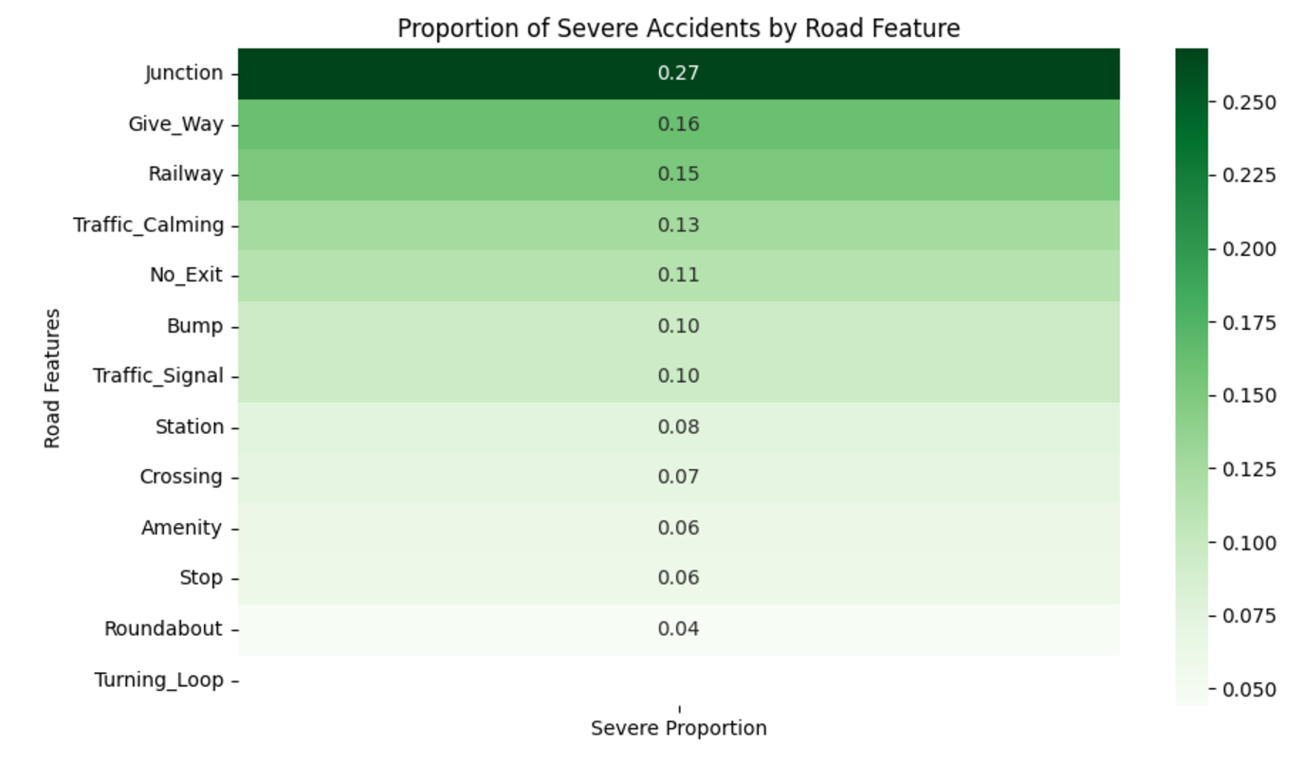
PROPORTION OF SEVERE ACCIDEnts by road feature
This heatmap visualizes the proportion of severe accidents associated with different road features. The proportion was calculated by dividing the number of severe accidents (severity > 2) by the total accidents for each feature. Junctions have the highest proportion (27%), followed by give-way areas and railways, suggesting these are particularly risky locations.
Features like roundabouts and turning loops have the lowest proportions, indicating safer conditions. These insights can help prioritize safety interventions at high-risk road features to reduce accident severity.

Slide 24
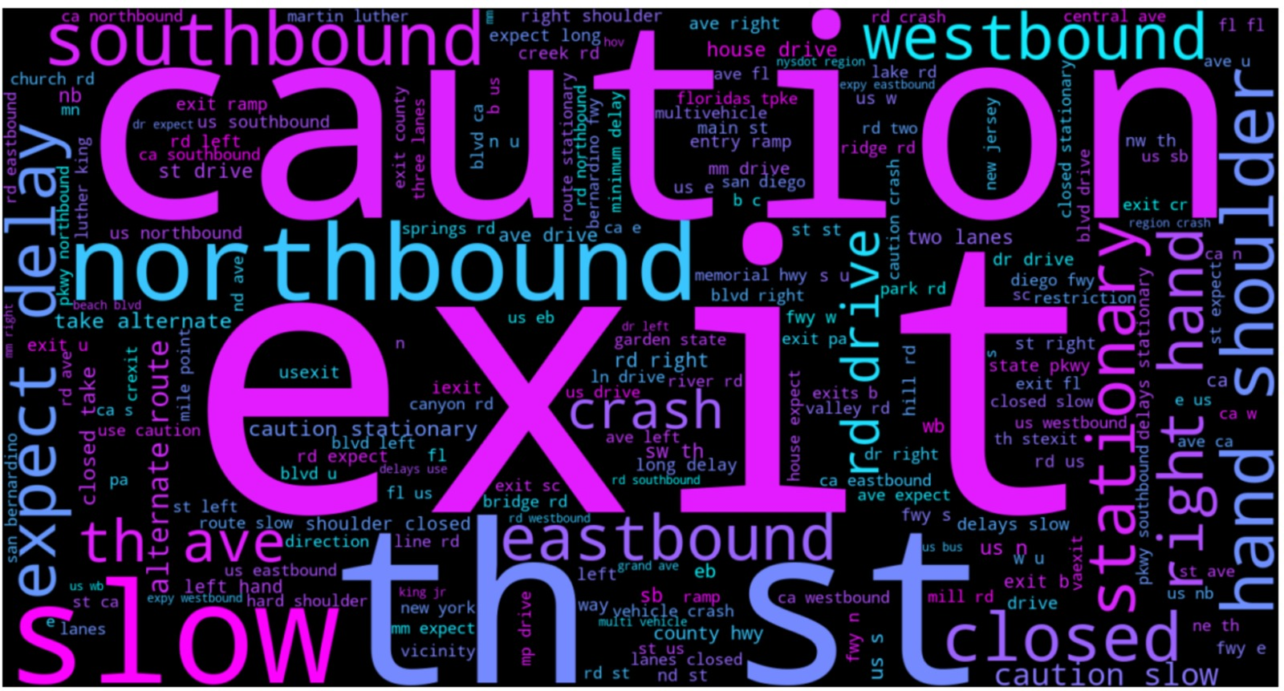
Word cloud of accident descriptions
This word cloud visualizes the most frequently used terms in accident descriptions, generated by normalizing text, removing punctuation, and excluding common stopwords and irrelevant words like "road" and "traffic." Prominent words such as "caution," "exit," and "northbound" suggest recurring themes of warnings, specific directions, and critical areas. The visualization highlights areas like ramps, exits, and directional flows as frequent contexts for accidents. These insights can guide targeted improvements in road signage and traffic management to address common accident scenarios.

Slide 25
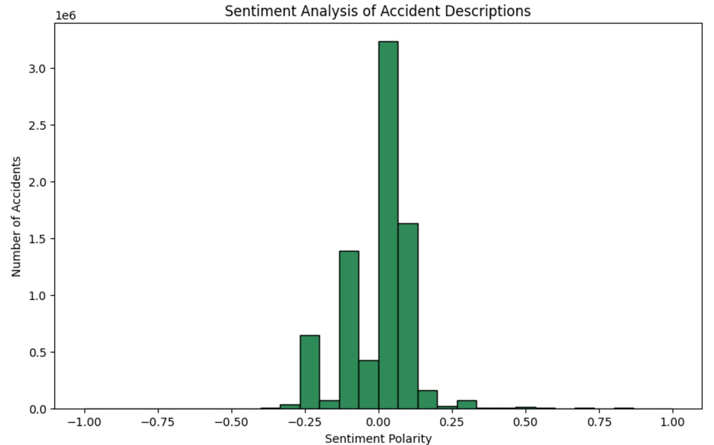
Sentiment analysis of accident descriptions
This histogram visualizes the sentiment polarity of accident descriptions, where values range from -1 (negative sentiment) to 1 (positive sentiment). Most descriptions cluster around neutral sentiment (0), indicating a lack of strong emotional language.
There is a slight skew towards negative sentiment, reflecting the nature of accident-related descriptions. These insights could be useful for understanding public reactions or highlighting critical incidents.

Slide 26
MAJOR TAKEAWAYS
Cities like Los Angeles and Miami emerge as major accident hotspots, driven by high population density and complex road networks, indicating the urgent need for targeted urban traffic solutions.
Accidents exhibit seasonal and daily patterns, peaking during winter months due to harsh weather and during weekday rush hours, exposing weaknesses in commuter traffic and weather preparedness.
Junctions, crossings, and traffic signals account for the highest proportion of severe accidents, making them critical zones for infrastructure upgrades and safety measures.
Non-survivable accident clusters in cities such as Atlanta are linked to inadequate nearby amenities and delayed emergency response times, highlighting gaps in emergency infrastructure.
Poor visibility, heavy precipitation, and extreme weather significantly elevate accident risks, reinforcing the need for weather-responsive safety protocols.
Sentiment analysis of accident descriptions reveals frequent mentions of "caution" and directional hazards, reflecting public awareness of road safety concerns.
State-level analysis highlights California and Florida with the highest accident risk scores, driven by a combination of high severity and frequency, necessitating state-specific road safety interventions.

Slide 27
CONCLUSION
The analysis of U.S. accident data reveals a multifaceted interplay of environmental conditions, infrastructure gaps, and human behavior contributing to road safety challenges. From severe accident hotspots in key cities to weather-induced risk patterns and infrastructure deficiencies, the data tells a compelling story of vulnerabilities that demand strategic interventions. Addressing these issues requires a holistic approach, enhancing infrastructure, optimizing emergency response systems, and fostering weather-resilient safety measures. By leveraging these insights, stakeholders can craft targeted solutions that not only reduce accident frequency but also improve survivability and overall traffic safety, paving the way for safer roads nationwide.

Slide 28
Thank you

